Slide 1
64-bit Adder using Ling equation

Slide 2
Critical Path
There are 8 stages to get the final sum
Stage 1: get carry generation signal(use domino AND) and carry propagation signal(use domino OR) for every bit position.
Stage 2 ~ 7: fuse carry generation signals and carry propagation signals in different bit positions. During the process of carry generation signals fusion, we use domino OR in stage 2 and domino AO in the other stages.
Stage 8: Use fused carry generation signals to select pre-compute sums.

Slide 3
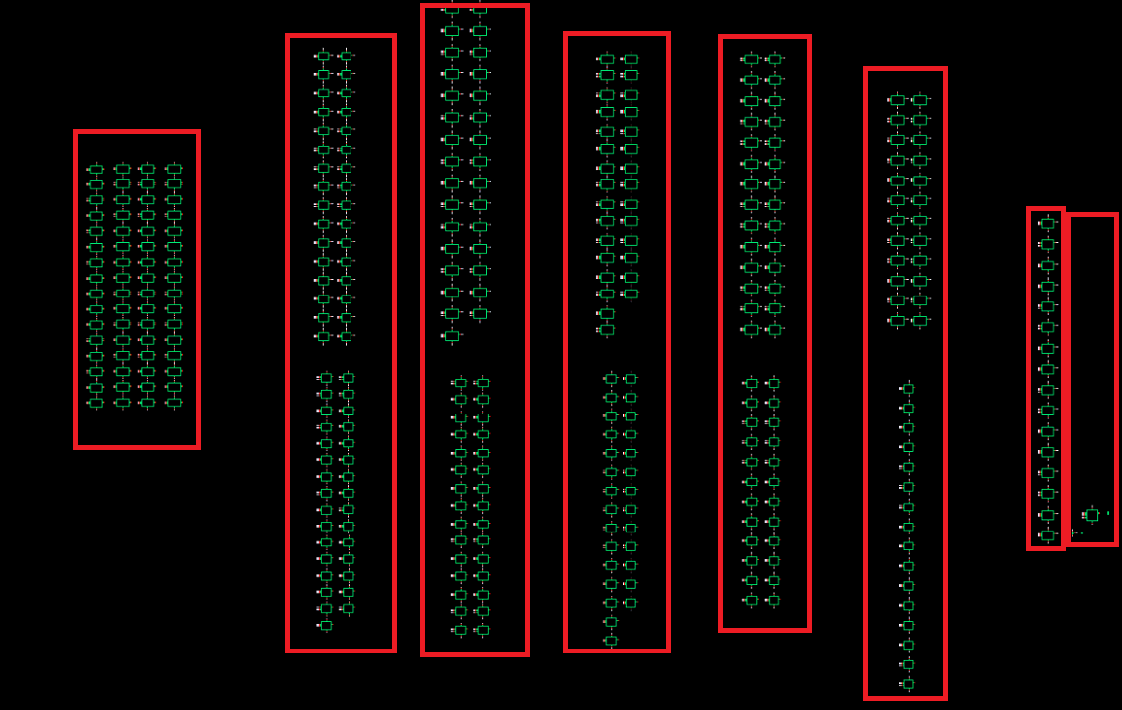
Critical Path
The total path is 1 domino and(domino or) + 1 domino or + 5 domino AO + 1 2:1 Mux

Slide 4
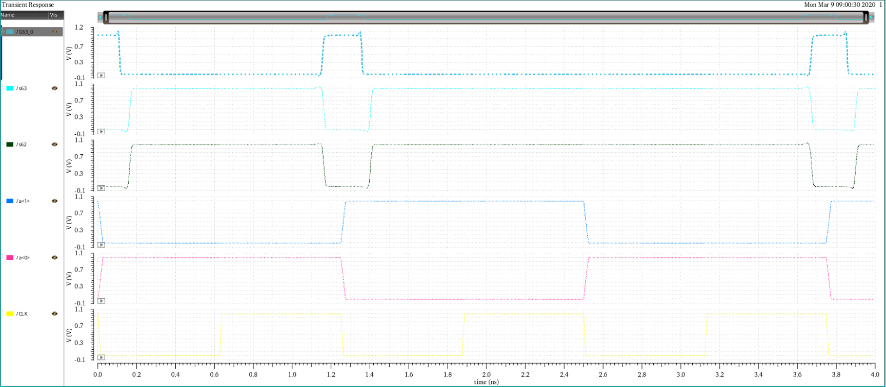
Simulation results
Clock period = 1.25ns(0000…0001 + 1111…1111)

Slide 5
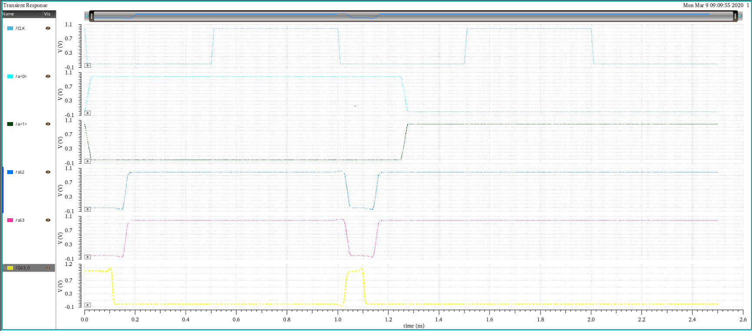
Simulation results
Clock period = 1ns(0000…0001 + 1111…1111)

Slide 6
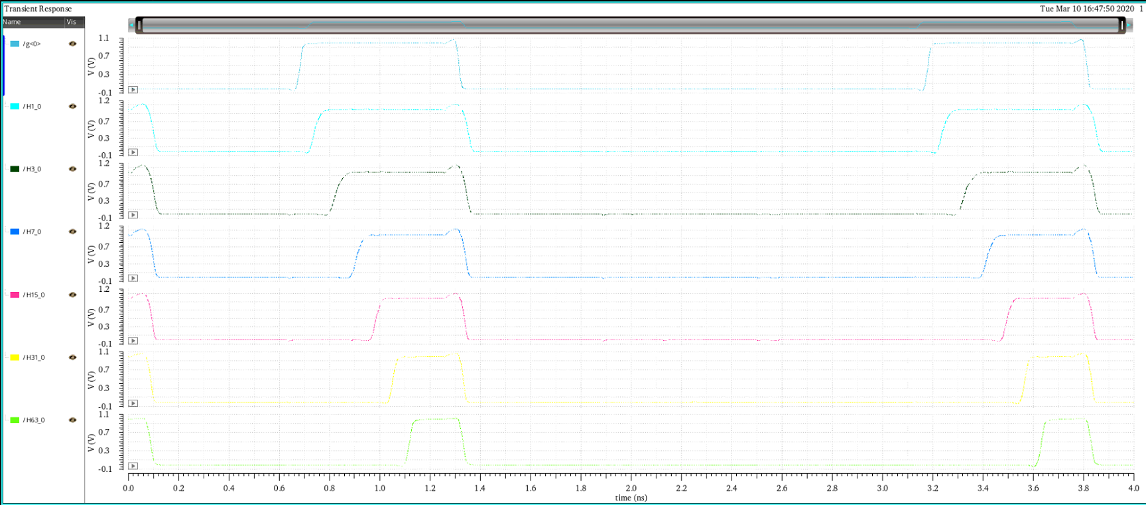
Improvements
The time needed in pre-charge stage is less than the time needed in compute stage.

Slide 7
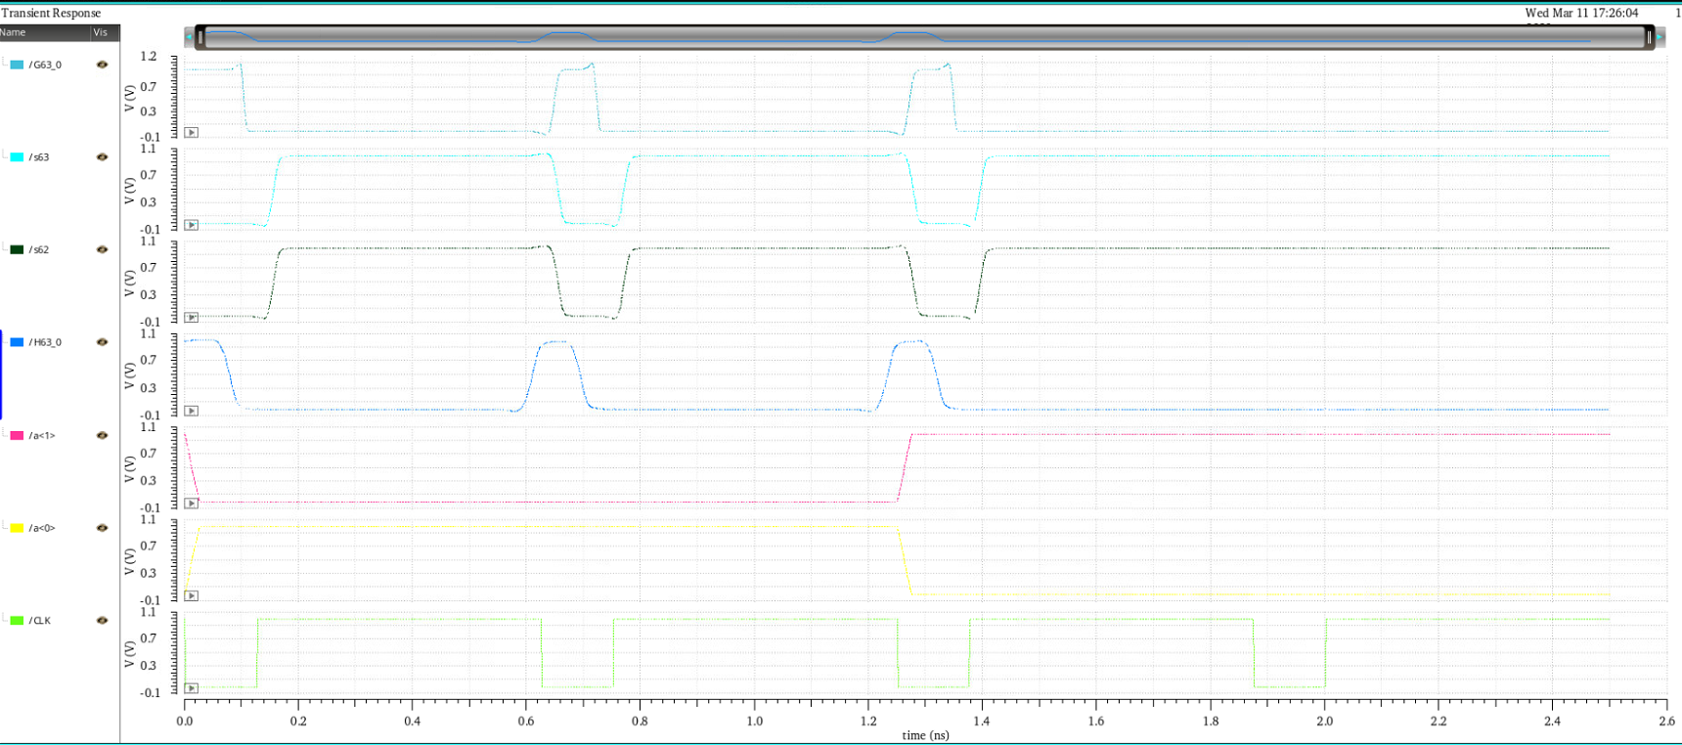
Improvements
Reduce the low level duration time of clock signal to increase the clock frequency.

Slide 8
2020/03/16

Slide 9
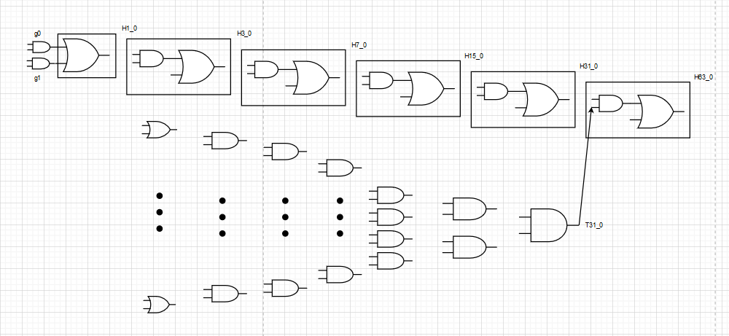
Critical Path

Slide 10
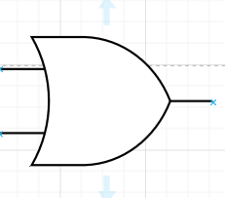
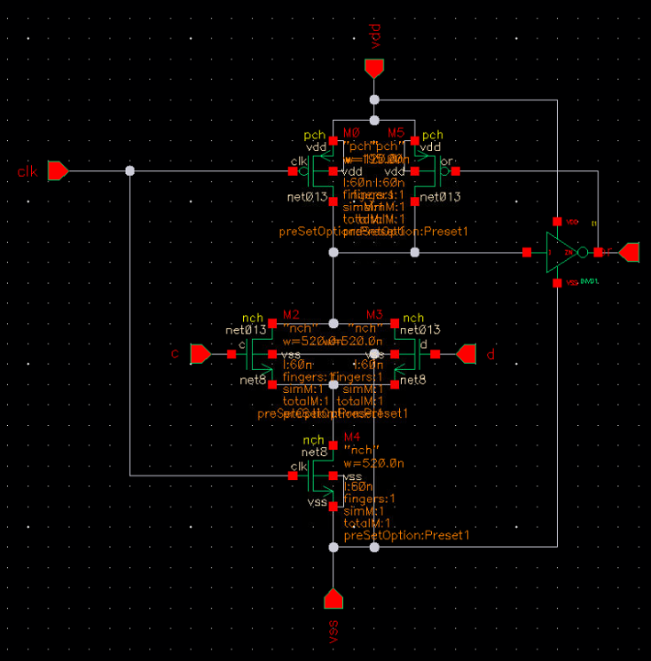
Size of domino gate
L: 60n
W: (M0, 195n), (M5, 120n), (M2, 520n), (M3, 520n), (M4, 520n)

Slide 11
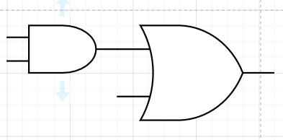
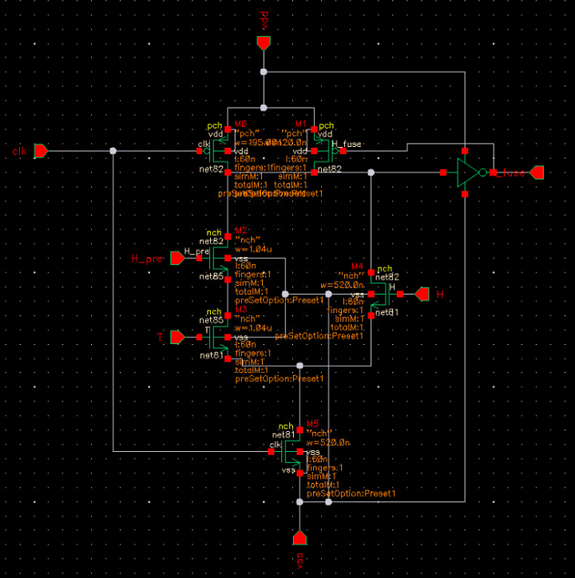
Size of domino gate
L: 60n
W: (M0, 195n), (M5, 120n), (M2, 1.04u), (M3, 1.04u), (M4, 520n), (M4, 520n)

Slide 12
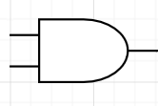
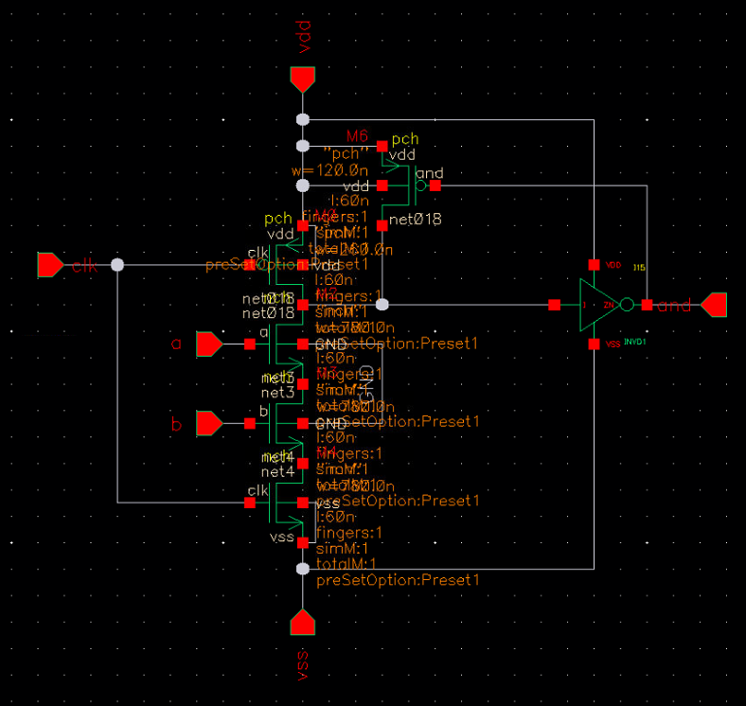
Size of domino gate
L: 60n
W: (M0, 195n), (M6, 120n), (M2, 780n), (M3, 780n), (M4, 780n)

Slide 13
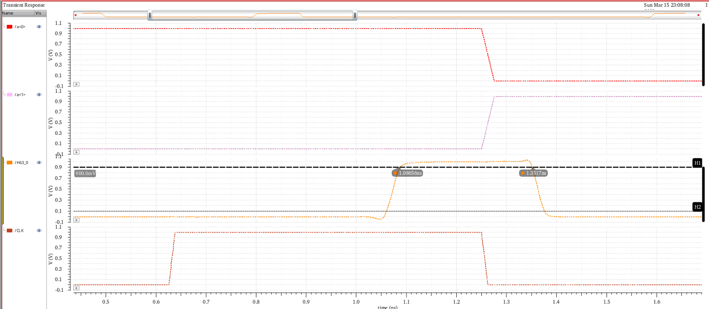


Simulation
$$t_{PLH}=461.56ps$$
$$t_{PHL}=126.09ps$$

Slide 14
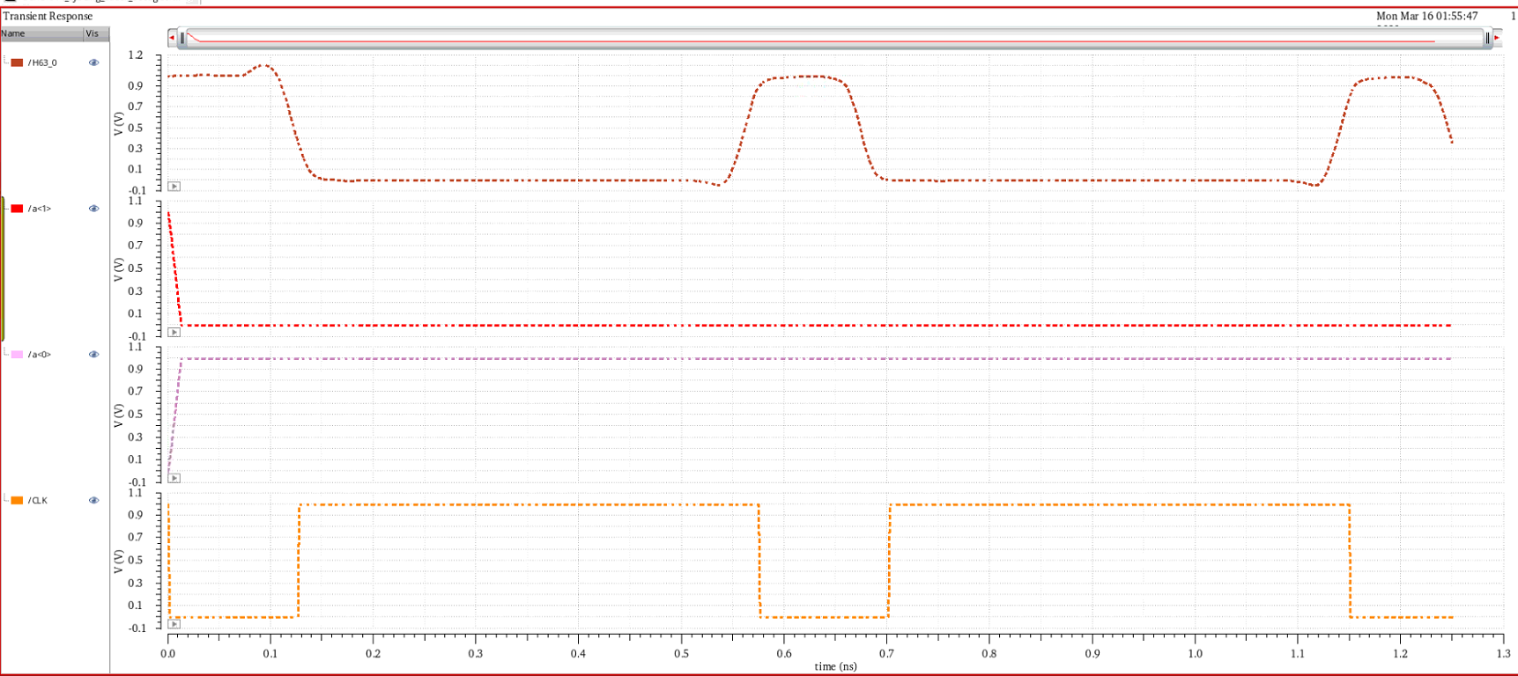
Simulation
Clock period = 575ps

